Slide 1
iTower
Midterm

Slide 2
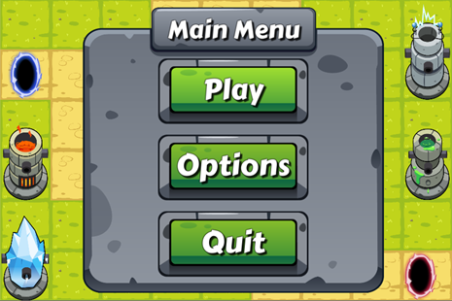
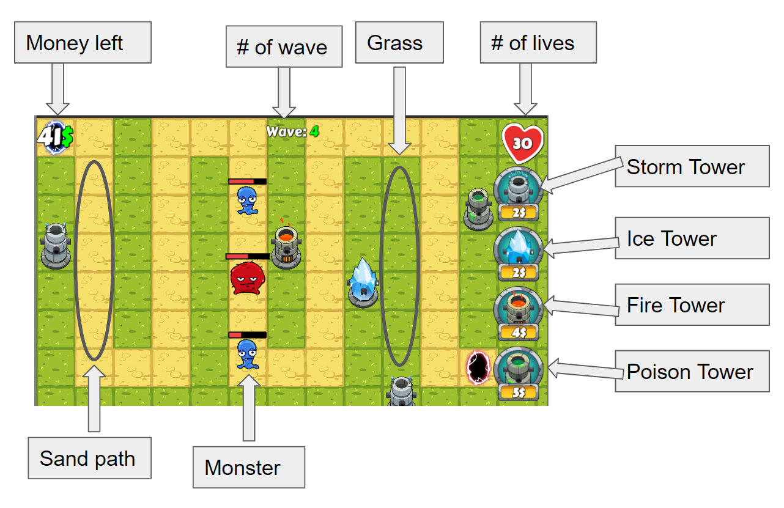
Project Overview
Click “Play” button
Purchase towers
Place towers
Click “Next wave” button
Monsters show up from the blue portal and try to reach the red portal
Game objective: For each wave, keep current life greater than 0 after last monster is killed or arrives at destination

Slide 3
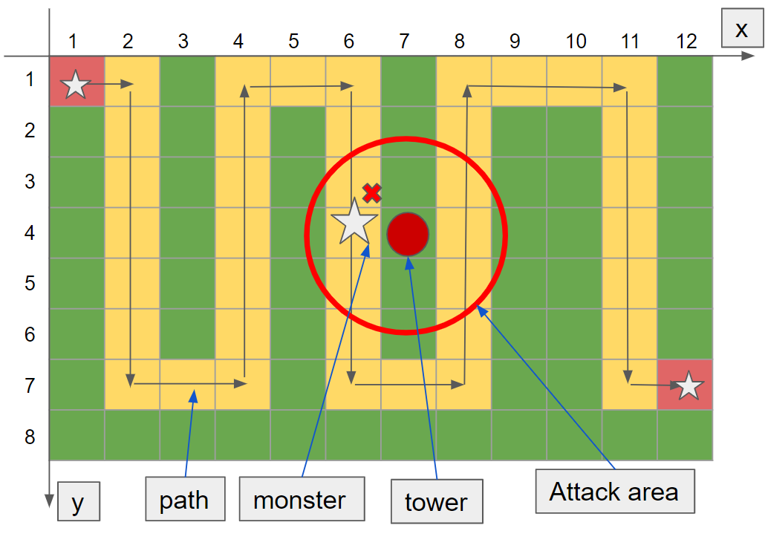
Project Goal
Create an agent that could learn to play the game wisely (higher current money and life)
Factors to be considered:
Current money: numbers
Current monsters: numbers and types
Towers: costs and types
Expected agent behaviors:
Select the proper types of towers
Place towers at proper time and location
Upgrade properties of the towers.

Slide 4
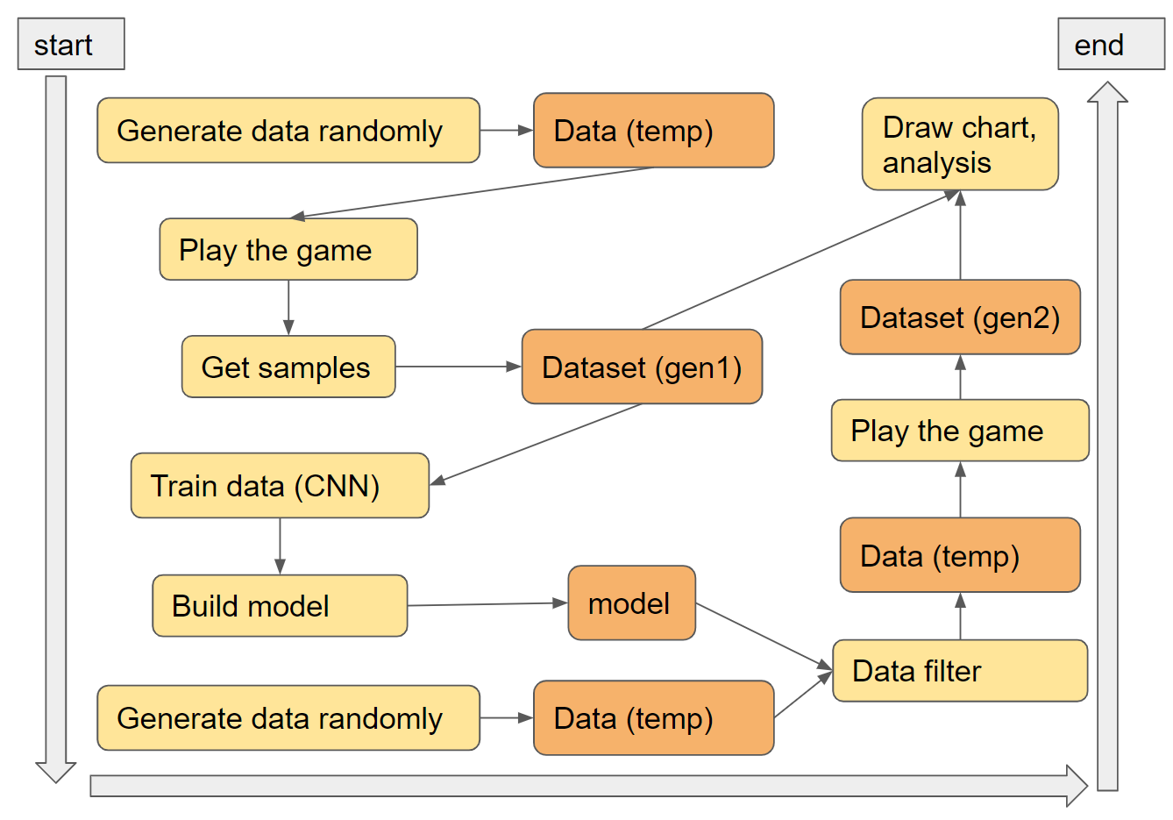
Project Details
Game Modification
Communication Design
Raw Data Collection
Data Pre-processing and Labeling
Machine Learning Application

Slide 5
Game Modification
Events | Before | After | Reason
Tower Instantiation | Manually click buttons, track coordinates and place tower | Agent automatically generate the coordinates and place tower | More convenient
Monster Life | Low | High | Make sure monsters reach destination
Monster Speed | Slow | Fast | Less play time
Monster Amount per Wave | +1 for the next wave | *2 for the next wave | Less perfect game results
Monsters routes | A* algorithm | Fixed routes along the yellow path | Prevent monsters walking through tower

Slide 6
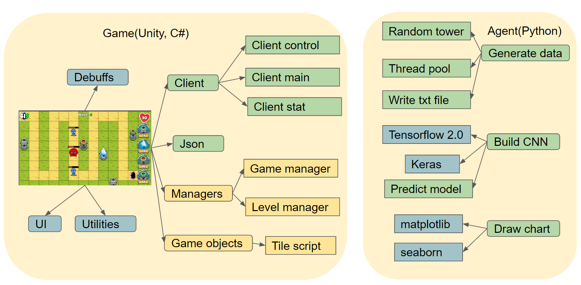
Communication Design

Slide 7
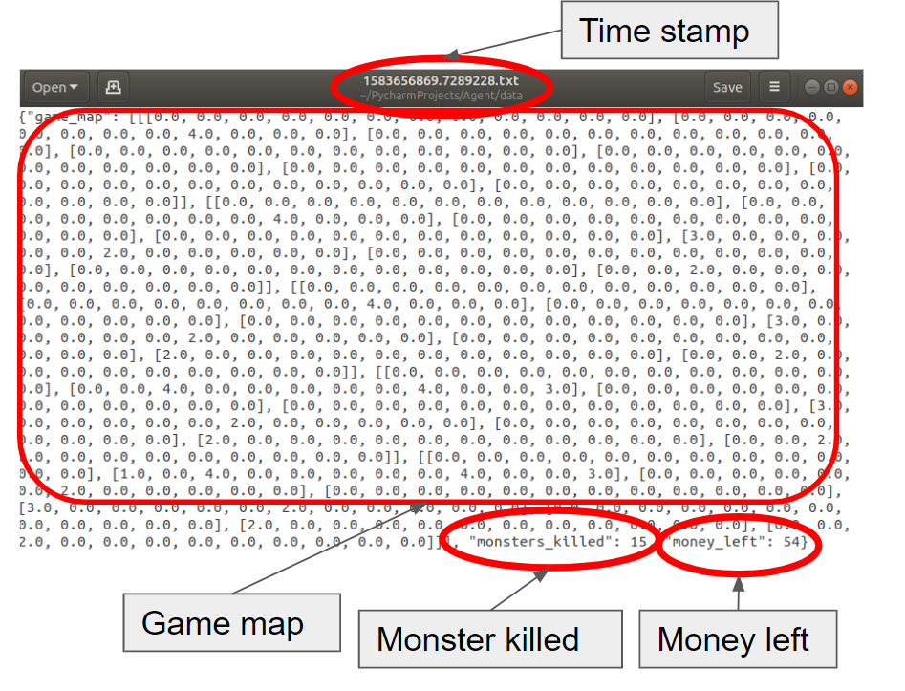
Raw Data Collection
Over 8,000 groups of raw data by using the agent to play within 5 waves.
Data Contents:
Game map: 3D matrix containing tower type and coordinates
Total number of monsters killed
Current money: gained by killing monsters and spent by buying towers

Slide 8
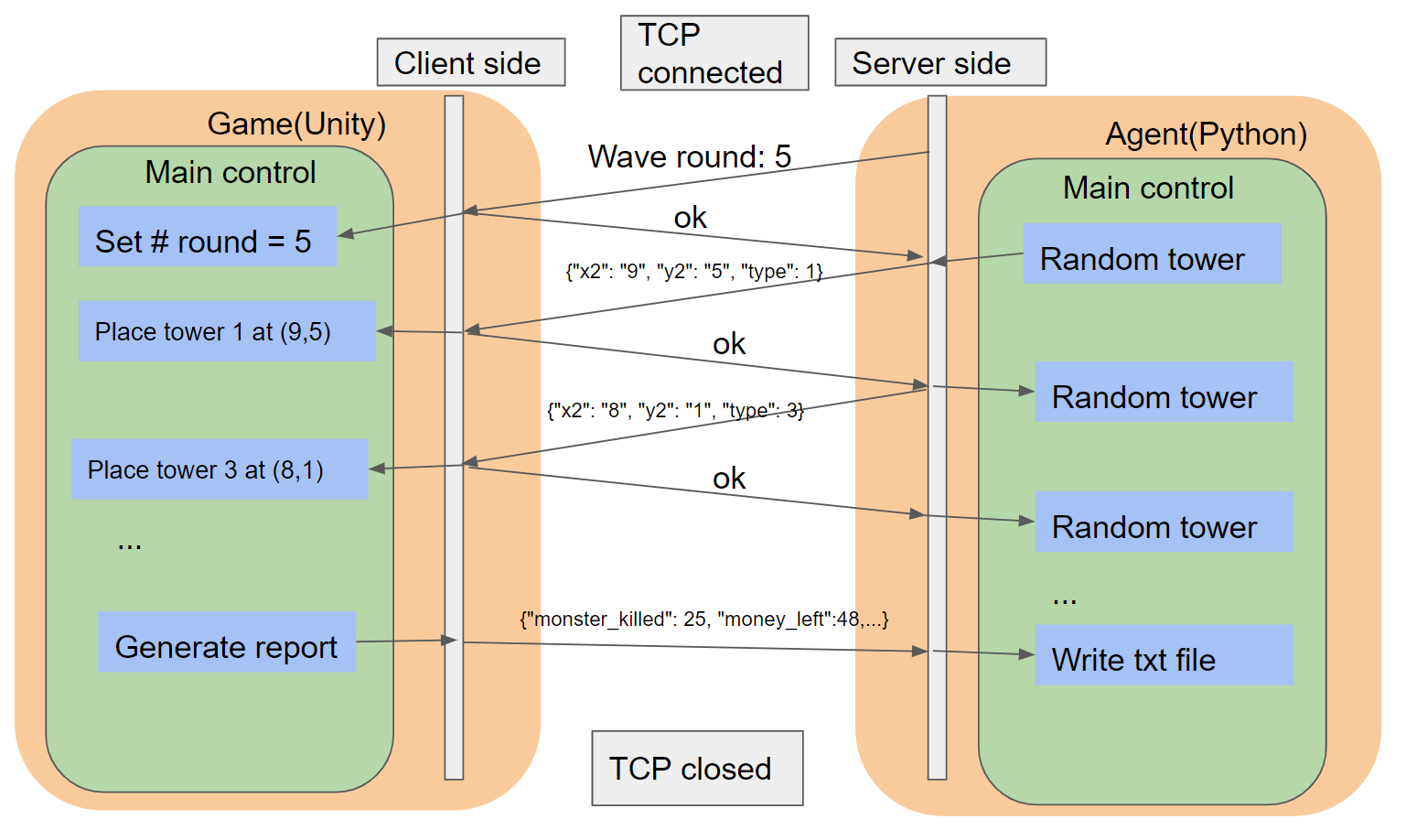
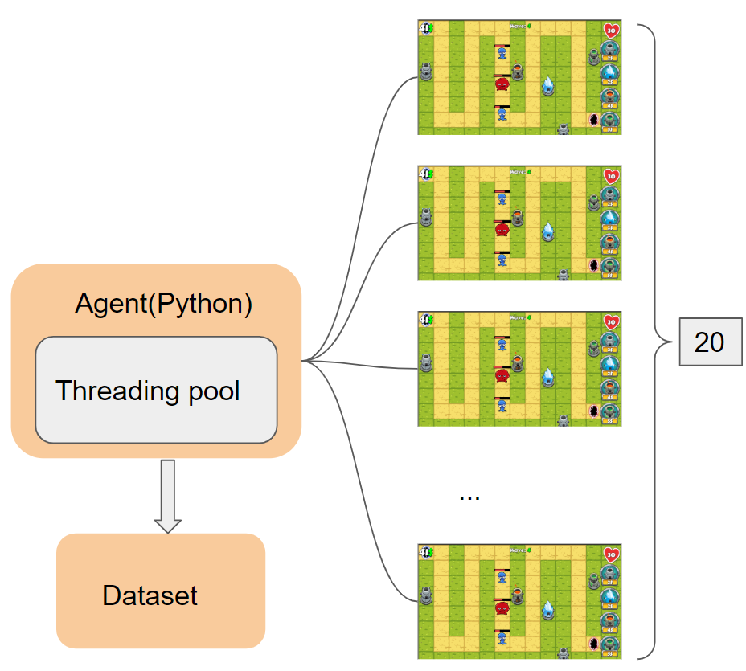
Raw Data Collection

Slide 9
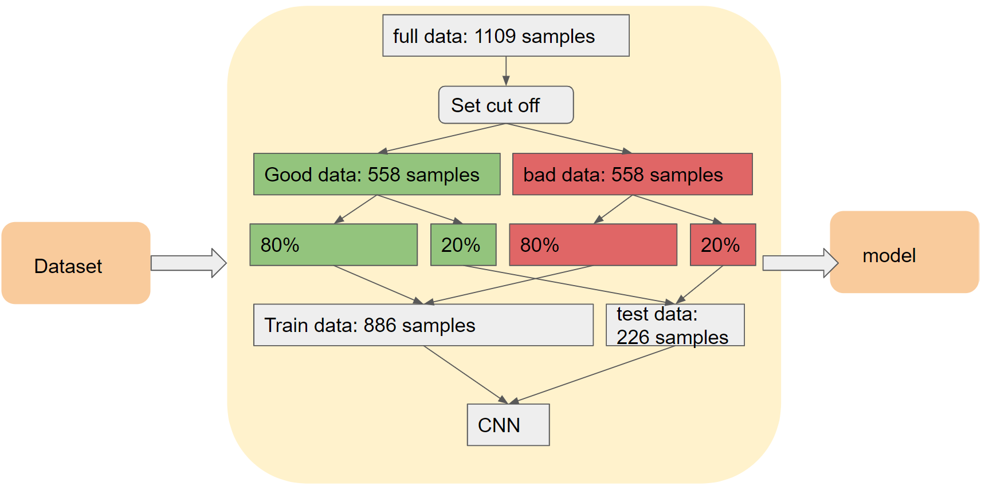
Data Pre-processing and Labeling

Slide 10
Data Pre-processing and Labeling
Pre-processing: over 1,100 groups of carefully selected data based on the following criteria:
Play 5 waves successfully.
Kill a relatively high number of monsters (above average).
Earn relatively more money (above average).
Labeling: cutoff binary labeling method
Label | Comment
1 | The dataset with higher number than the average monsters killed and more money than the average money left)
0 | The rest are labeled by 0.

Slide 11
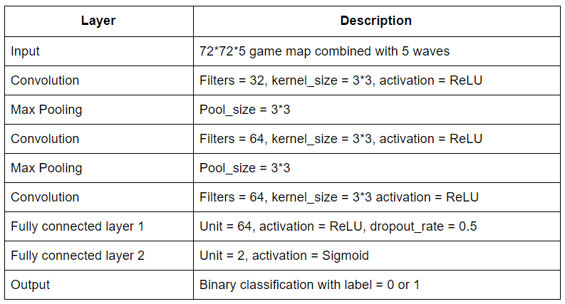
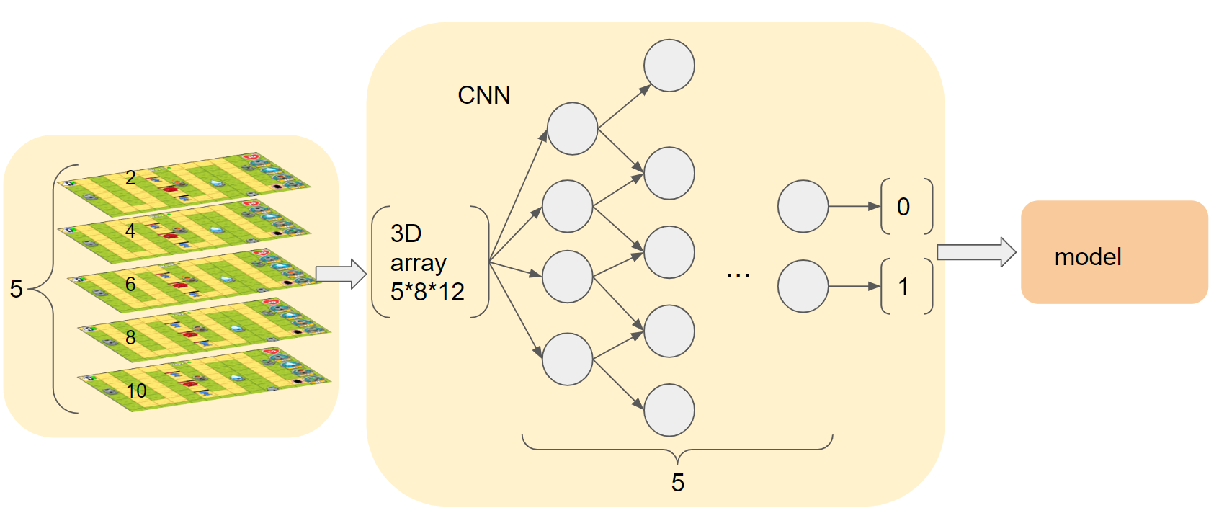
ML Application

Slide 12
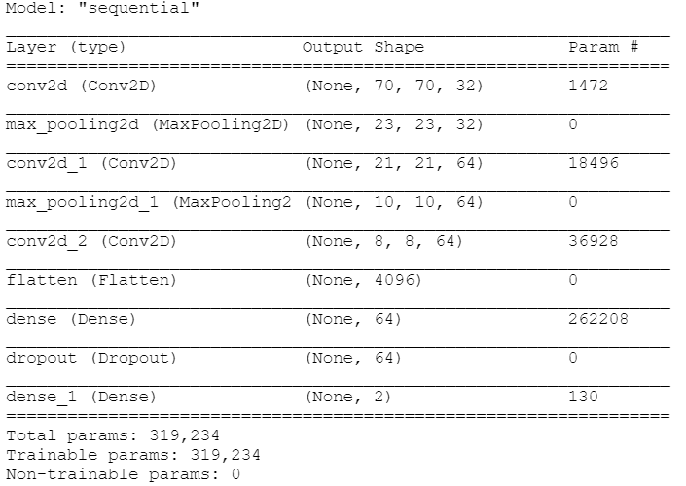
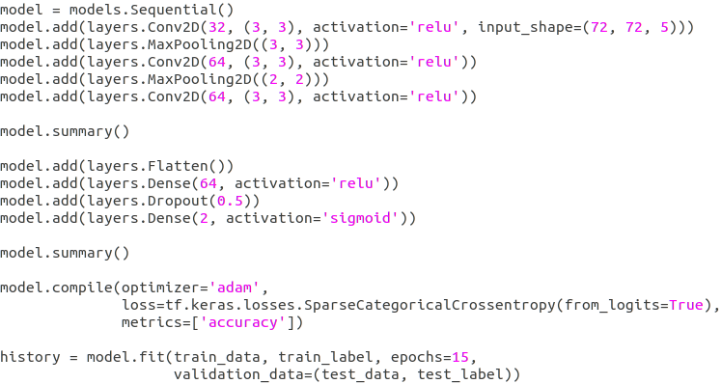
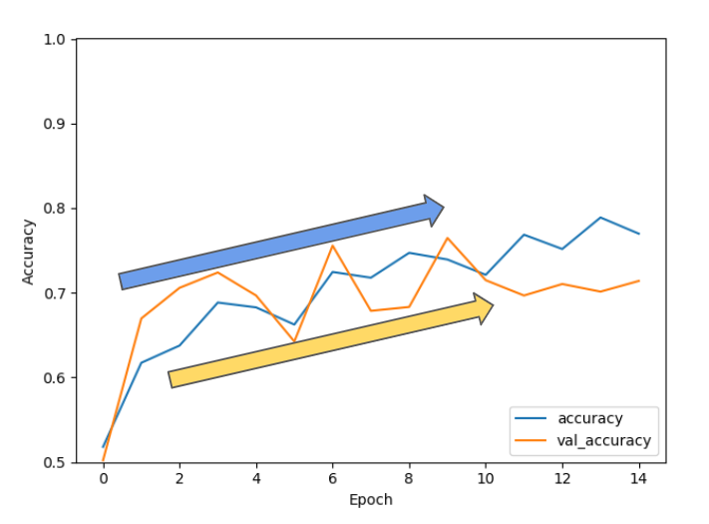
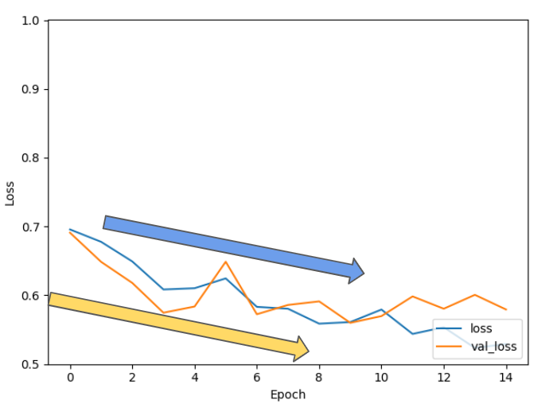
Accuracy
Loss

Slide 13
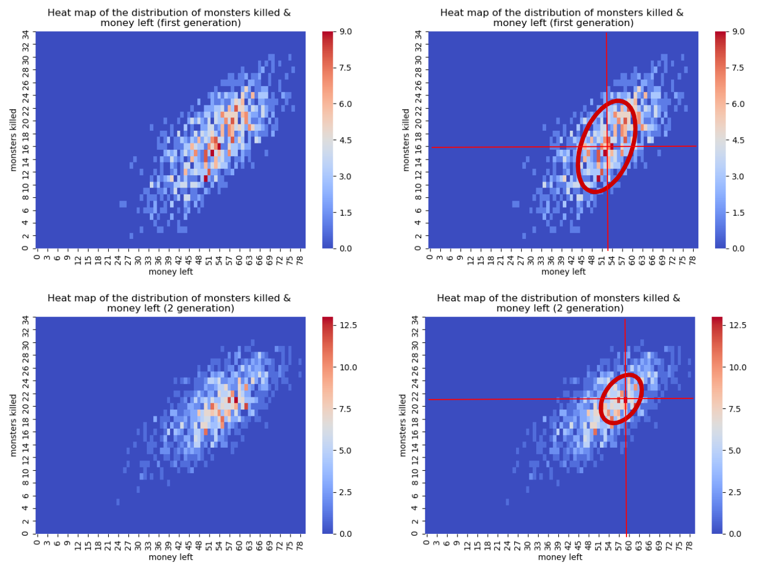
Before learning
After learning

Slide 14
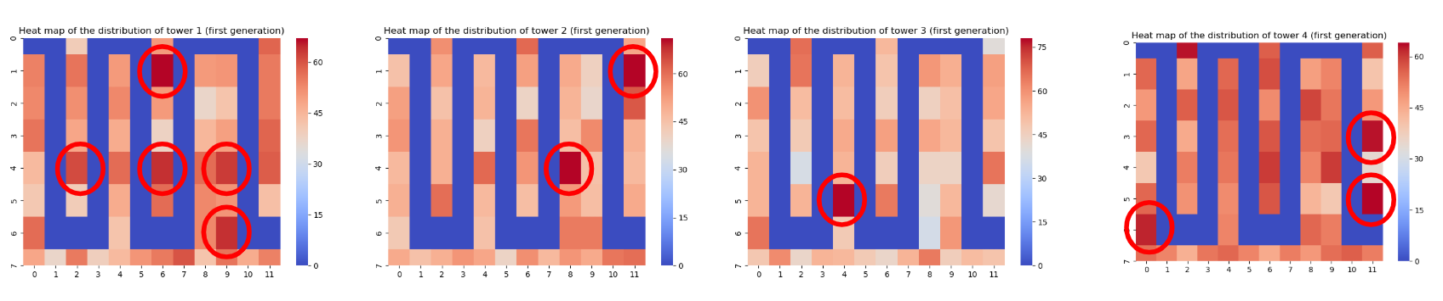
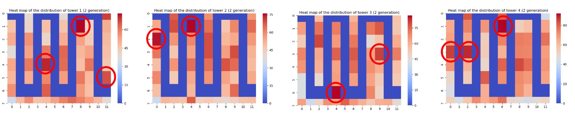
After learning
Before learning

Slide 15
Future Plan
Optimize the neural network:
Tune the hyper-parameters and algorithms to reach the AI agent more intelligent.

Slide 16
Demo Video
https://drive.google.com/file/d/1pWoVSPC1j1ULdNFJ0Fpm1Dc_xB2YT61m/view?usp=sharing

Slide 17
Thanks

